Slide 1

Handler Reporting Quick Start Guide
2024 CY

Slide 2
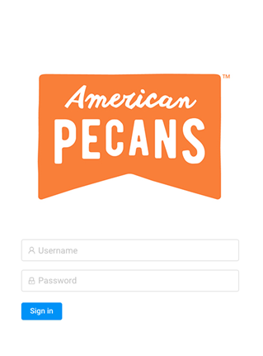
Handler Portal Overview
Once logged in to the portal, you will view the dashboard home page. Here you will find status summaries for current year and prior year reporting, as well as assessments and year-end reporting.

Slide 3
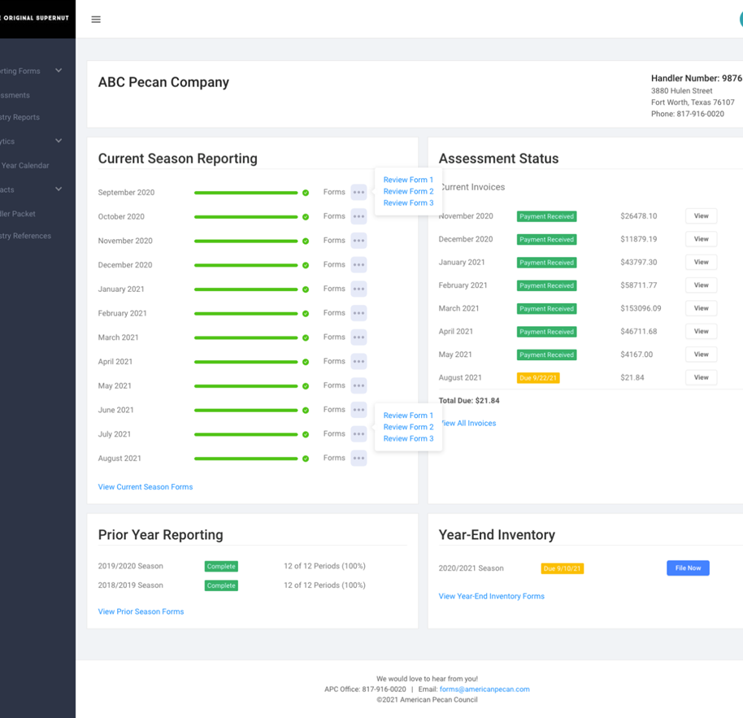
Current Season Reporting
This section reviews the current season reporting progress for your company. Each reporting period is summarized by a progress bar showing your progress toward forms package completion for the period. Several links are also available to take action on your reporting forms.

Slide 4
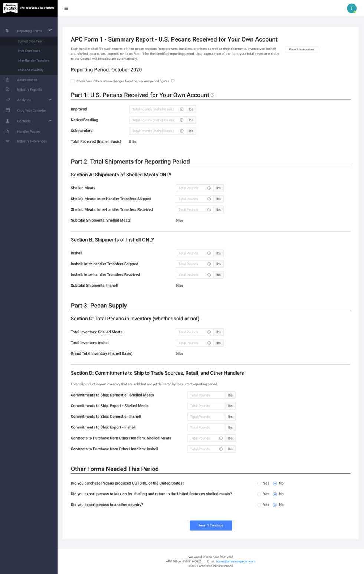
File Now
To file, you would select “File Now” for Form 1 and begin filling out the report as shown in the screenshot.
When filing, there will be helpful Info Bubbles by each line item that describe what to enter.
Once you have entered in the data, you will click the Blue Form 1 continue button which will take you to the Review and Certify page.

Slide 5
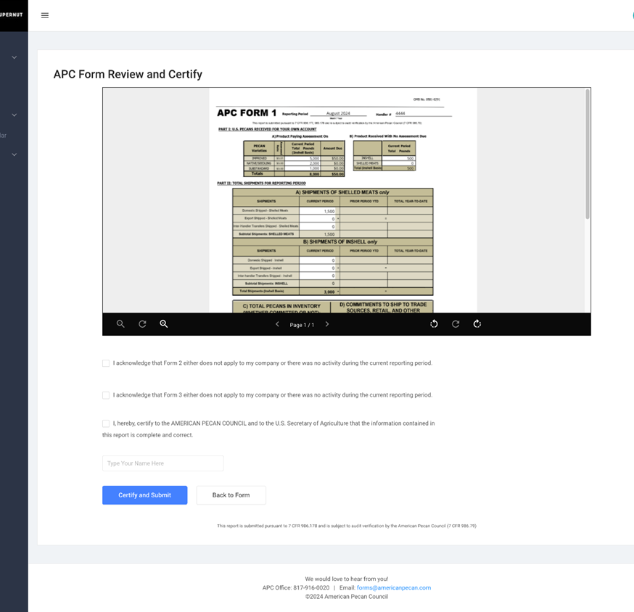
After you review the PDF generated form based on the data you inputted in Form 1 for accuracy, you will check the three boxes if all is correct and click “Certify and Submit”.
Form Review and Certify

Slide 6
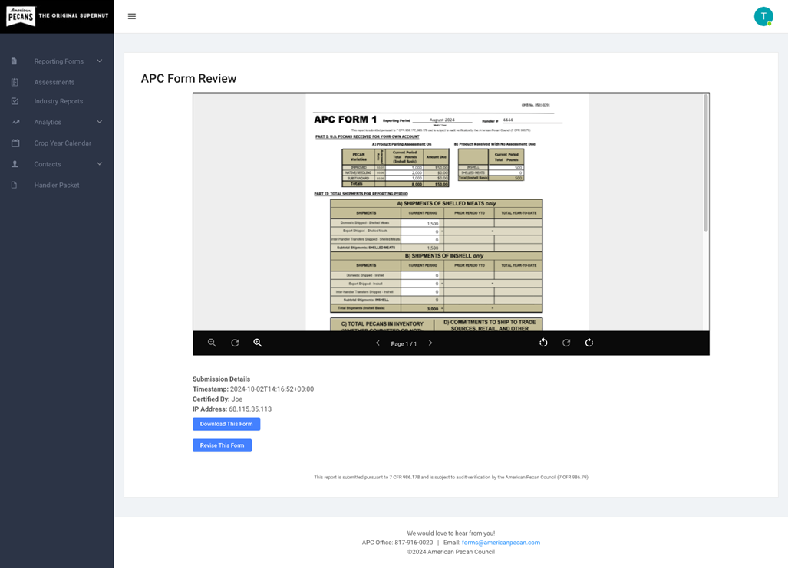
Revising Reporting Forms
If you need to revise a reporting form, you will go under “Current Season Reporting”, click “Review Form”, and you will have the option to “Revise This Form”.

Slide 7
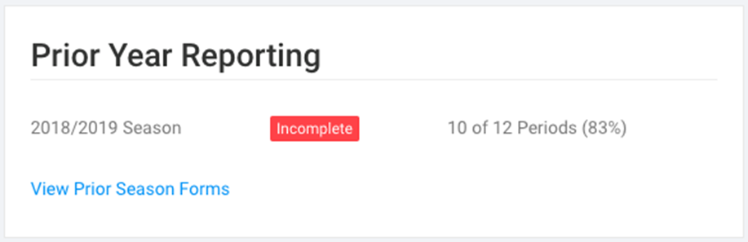
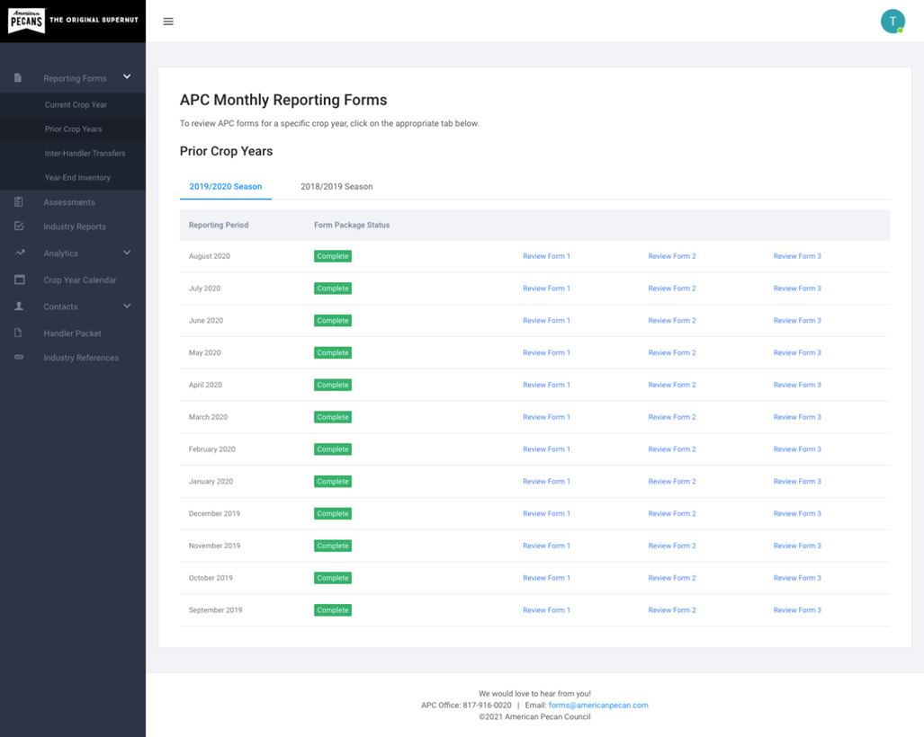
Prior Year Reporting
This section reviews your reporting progress through prior crop years.

Slide 8
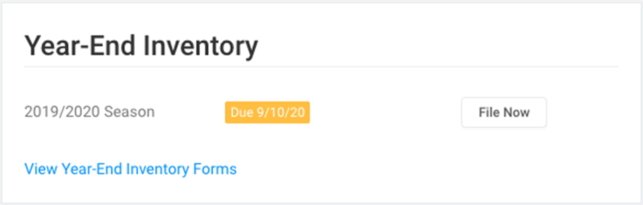
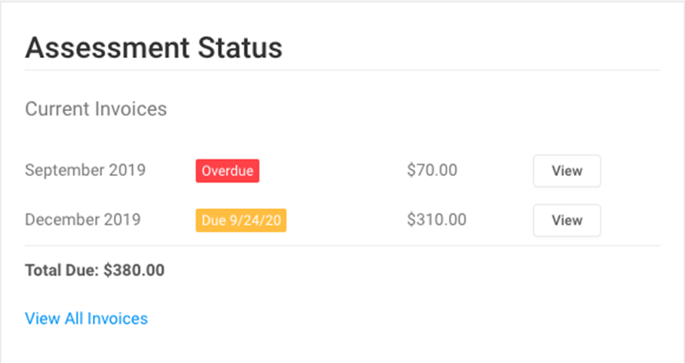
Year-end Inventory
As the end of a crop year approaches, this section will provide information about completing your year-end inventory form. A link to file APC Form 5 will be available.
Assessments
Upon successful filing of APC Form 1, a new assessment may be due. When this occurs, an invoice will be generated and shown in the Assessments section of the dashboard home page. The invoice can be viewed, downloaded, and submitted to APC together with payment (offline).
After receipt of payment by APC, the invoice status will change to “Received”, indicating successful completion of your assessment payment.

Slide 9
Handler Portal Menu
The left sidebar of the portal contains a series of menu items linking to important pages within the site. These are:
Reporting Forms: Current Crop Year. An expanded summary of all current crop year reporting forms packages. Contains links to file and review all current year forms.
Reporting Forms: Prior Crop Years. An expanded summary of all reporting forms packages from prior crop years. Crop years can be navigated using the tabs at the top of the table list.
Reporting Forms: Inter-handler Transfers (Form 4). A table of all inter-handler transfer agreements your company is party to, organized by transferring and/or receiving handlers. Download button to obtain a new Form 4 document.
Reporting Forms: Year-End Inventory. An expanded summary of year-end inventory forms for your company. Contains links to file and review required year-end inventory forms.
Assessments. An expanded summary of all current season assessments. Contains links to invoices and Form 1 generating the assessment.
Industry Reports. Monthly and annual position reports available by season. Reports can be navigated using tabs above the table list.
Analytics. Graphical reporting of reporting data for your company.
Crop Year Calendar. Crop year reporting and deadline information.
Contacts: Company Contacts. A searchable contact list showing all users for your handler company.
Contacts: Handler Directory. A searchable contact list with basic information for all handler companies.
Documents: Handler Packet. Annual handler packet information and files.
Documents: FMO References.
Industry Links. Helpful links to other industry resources.

Slide 10

3880 Hulen Street, Suite 650, Fort Worth, Texas 76107 | P. O. Box 100398, Fort Worth, Texas 76185
PHONE (817) 916-0020 | FAX (866) 232-0085 | EMAIL: forms@americanpecan.com
CONNECT WITH US
americanpecan.com

